Slide 1

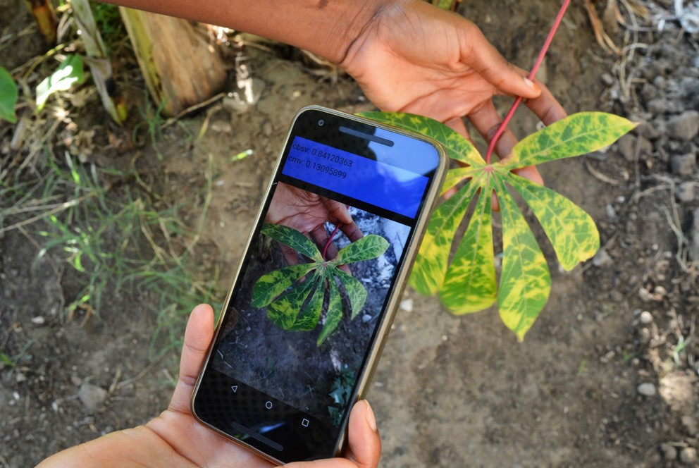
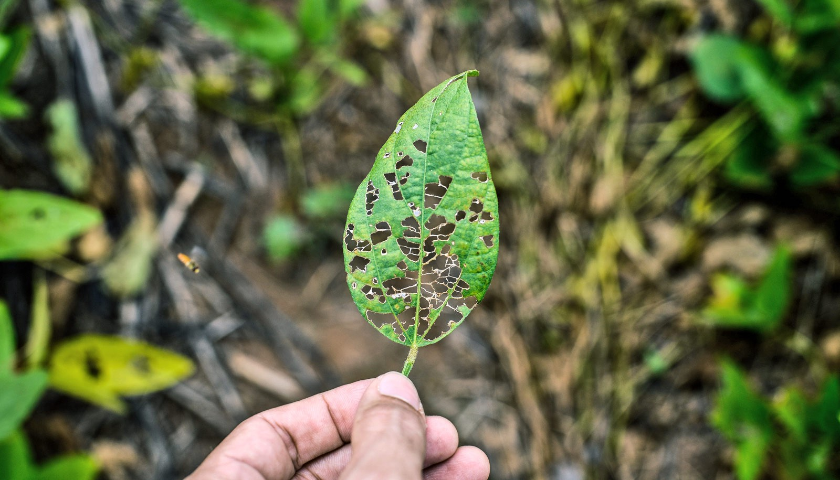
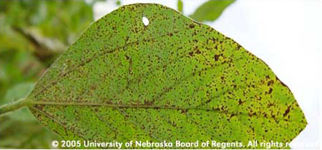
GOVERNMENT COLLEGE OF ENGINEERING NAGPUR
TEAM MEMBERS
1)VISHAL YADAV
2)AMAN SHARMA
3)ROHIT RAMTEKE
PLANT DISEASE DETECTION APP

Slide 2
Contents
Introduction
Problem statement
Problem statement description
Problem with existing system
Modules
Data flow diagram
Hardware and software requirements
Benefitted multitude
Future scope
references

Slide 3
PLANT DISEASE DETECTION APP
Timely and correct identification of disease when it first appears is a critical step for efficient disease management.
An app can be developed that the farmer can have on their smartphone with the following capabilities
1)identify the type of plant
2)Identify if the plant has disease or healthy.
3)In case the leaves are affected by disease classify the disease.
4)Provides treatment options(Pulls the information from the database with links to online sources)

Slide 4
PROBLEM STATEMENT
TO CREATE A PLANT DISEASE DETECTION APP AND SUGGEST REMEDIES FOR THAT.

Slide 5
PROBLEM STATEMENT DESCRIPTION
Agriculture plays a critical role in providing food supply for growing population of the world.
Annual global food supply loss due to plants diseased is 40%, on average.
Sometimes farmers can loose almost 100% of the crop due to plant diseases.This makes crop disease a major threat to food security around the world.

Slide 6
PROBLEM WITH EXISTING SYSTEM
THE TRADITIONAL METHOD OF DETECTING DISEASE IN PLANTS REQUIRE LARGE MANPOWER,MORE PROCESSING TIME,EXTENSIVE KNOWLEDGE AND SKILLS ABOUT PLANT DISEASES.
FARMERS ARE ALSO NOT THAT MUCH AWARE OF THE REMEDIES THAT CAN BE TAKEN TO PREVENT THOSE DISEASES.

Slide 7
MODULES
PYTHON 3.6 OR >
KERAS
SCIKIT-LEARN
MATPLOTLIB
OPENCV
SQLITE3

Slide 8
KERAS
KERAS IS AN OPEN-SOURCE SOFTWARE LIBRARY THAT PROVIDES A PYTHON INTERFACE FOR ARTIFICIAL NEURAL NETWORKS.
KERAS ACT AS AN INTERFACE FOR TENSORFLOW LIBRARY.
SCIKIT-LEARN
SCIKIT LEARN IS A FREE SOFTWARE MACHINE LEARNING LIBRARY FOR PYTHON LANGUAGE.
It features various classification, regression and clustering algorithms including support vector machines, random forests, gradient boosting, k-means and DBSCAN, and is designed to interoperate with the Python numerical and scientific libraries NumPy and SciPy.

Slide 9
MATPLOTLIB
Matplotlib is a plotting library for the Python programming language and its numerical mathematics extension NumPy OPENCV
OPENCV(OPEN SOURCE COMPUTER VISION LIBRARY) IS AN OPEN SOURCE COMPUTER VISION AND MACHINE LEARNING SOFTWARE LIBRARY.
It has C++, Python, Java and MATLAB interfaces and supports Windows, Linux, Android and Mac OS.
The library has more than 2500 optimized algorithms which can be used to detect and recognize faces, identify objects, classify human actions in videos, track camera movements, track moving objects, extract 3D models of objects, produce 3D point clouds from stereo cameras, stitch images together to produce a high resolution image of an entire scene, find similar images from an image database, remove red eyes from images taken using flash, follow eye movements, recognize scenery and establish markers to overlay it with augmented reality, etc.

Slide 10
SQLITE3
sqlite3 is a DBMS which can be integrated with python and has many useful features along with the basic CRUD operations.
➢It is a very light but useful system and is supported on a wide range of platforms.
➢It is also faster than many other DBMS systems.

Slide 11
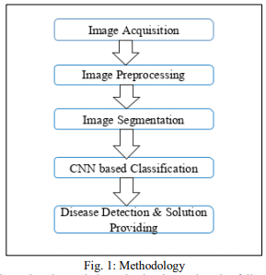
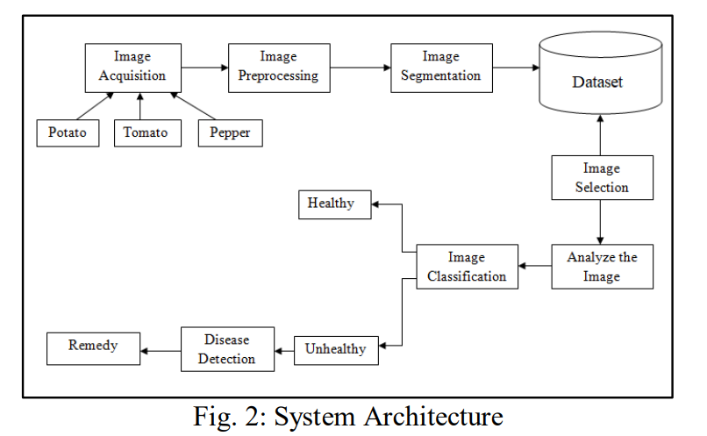
DATA FLOW DIAGRAM

Slide 12
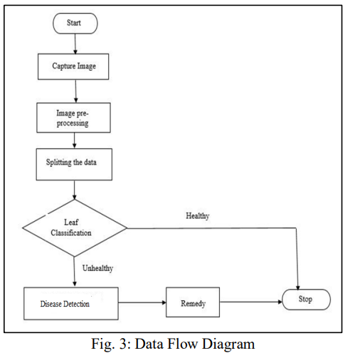
DATA FLOW DIAGRAM

Slide 13
Project HARDWARE REQUIREMENTS
Processsor :- i3 (Processsor)
Ram:- 8GB Ram
O.S:- Windows
Hard disk 30GB

Slide 14
SOFTWARE REQUIREMENTS
OPERATING SYSTEM: WINDOWS
ANDROID STUDIO
JDK,SDK
SQLITE3
SPYDER IDE
PROGRAMMING LANGUAGES:JAVA,PYTHON

Slide 15
How we built it
The AI Model
We used convolution networks for image classification of the disease classes. We converted the model and optimized it using the tensorflowlite format to be used on the android application in memory and time-efficient manner. The tensorflowlite converts the large heavy deep learning models to a smaller and mobile hardware supportive format. It also quantizes the parametric learning weights to reduce the model file size. For example, we converted our convolution model file of 2mb to 200kbs without compromising on the performance of the model. All the database for this app is stored locally to avoid the requirement of internet connection for its usage. The user just needs to click the image of his plant and the app helps them out with the rest.
The Android Application
The android application was developed using the android studio framework. The different phases of the application involve a live camera feed in the beginning. The user clicks an image from the camera feed. The application sends this image for preprocessing from where it is pushed as input to the AI model (The Magic Box). The AI model outputs the class of the plant and disease. We use this to pull out information about this plant and disease from our knowledge base. The application then displays all the relevant information about the prediction for the farmer's help.

Slide 16
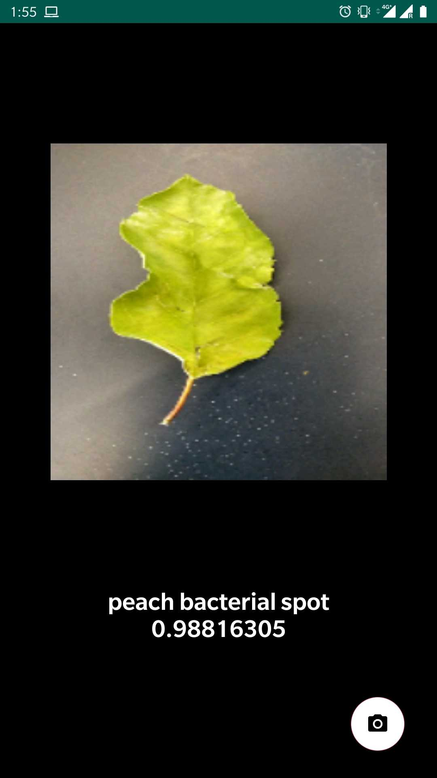
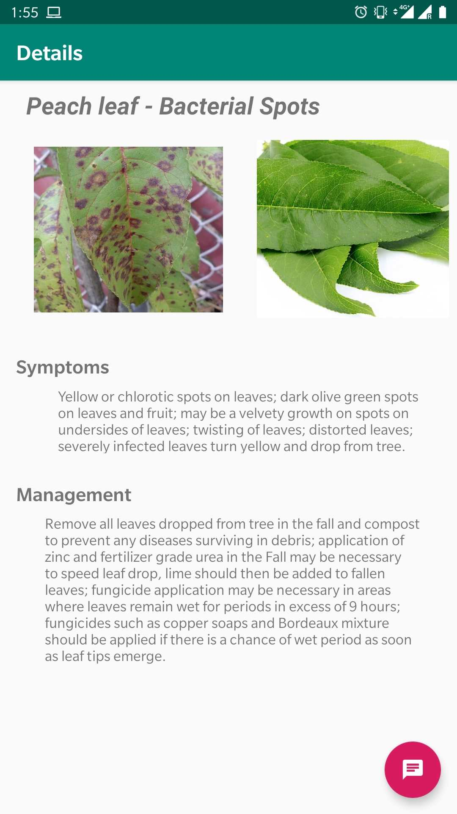
DEMO
install the app.
Start taking images
getting predictions.

Slide 17
BENEFITED MULTITUDE
Majority of farmer will be benefitted by this app.
People who work with plants will also be benefitted.

Slide 18
FUTURE SCOPE
In future will will be expanding our project so that it should be able to predict diseases in more that three plants .
Integrating climate data for crop yield prediction and recommendations.
Chatbot for personalised help.
Ordering fertilizer from ecommerce site.
Setting reminder for pesticides/watering etc
Advising on best practices.

Slide 19
references
www.google.com
www.wikepedia.com
https://www.kaggle.com/emmarex/plantdisease
Plant Disease Detection using Ai Techniques (IJSRD/Vol. 7/Issue 12/2020/27)

Slide 20
THANK YOU
OPEN FOR QUESTIONS

